Slide 1



2nd Undergraduate Conference on Intelligent Computing and Systems (UCICS 2026)
HOSTED BY: Varendra University, Rajshahi, Bangladesh
17-18 January, 2026
Paper ID:
Paper Title :
069
Rice Leaf Disease Detection Using Vision Transformer and Transfer Learning-Based Architectures
Mohammad Ali Sakib
Department of CSE
Pabna University of Science and Technology
Pabna, Bangladesh

Slide 2
Outlines :
Introduction
Motivation and problem statement
Literature Review
Proposed Idea
Methodology
Dataset
Models
Results
Conclusion
Future Work

Slide 3
Introduction
Rice is a major food crop
Rice leaf diseases reduce crop yield
Farmers mostly depend on manual checking
Manual checking is slow and inaccurate

Slide 4
Motivation & Problem Statement
Why do we do this?
What are the challenges?
Rice leaf diseases reduce crop yield
Manual disease checking is slow
Farmers cannot monitor large fields easily
Disease symptoms look very similar
Images have different lighting and backgrounds
CNN models miss global disease patterns
Our solution
Use Vision Transformer (ViT)
Learn both local and global features
Provide fast and accurate disease detection

Slide 5
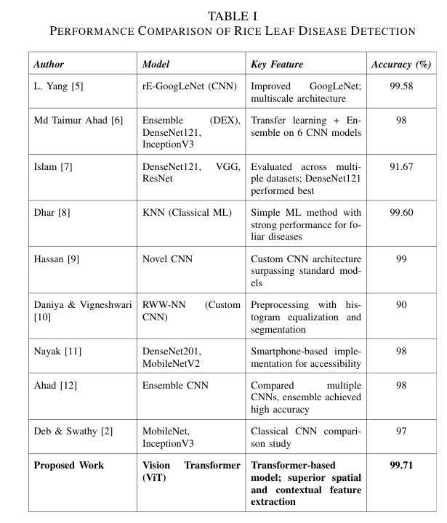
RELATED WORK / LITERATURE REVIEW
Research Gap
CNN models focus on small local features
They miss global disease patterns
Transformer models are rarely used
Need a more accurate solution

Slide 6
Proposed Idea
Use Vision Transformer (ViT)
Compare with MobileNetV3 and ResNet50
Learn both local and global features
Improve disease classification accuracy

Slide 7
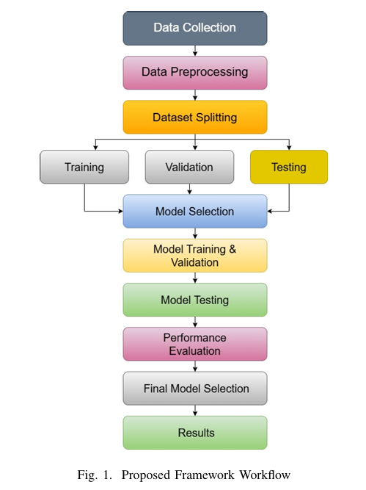
Methodology
Collect rice leaf images
Preprocess and augment images
Split dataset
Train and test models
Compare performance

Slide 8
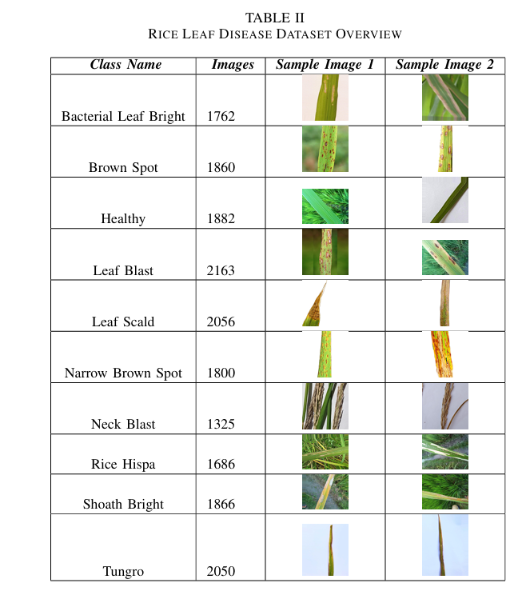
Dataset Overview :
Dataset collected from Kaggle
Total images: 18,450
10 rice leaf classes
Real-world image variations

Slide 9
Data Preprocessing :
Resize images
Normalize pixel values
Apply data augmentation
Improve model generalization

Slide 10
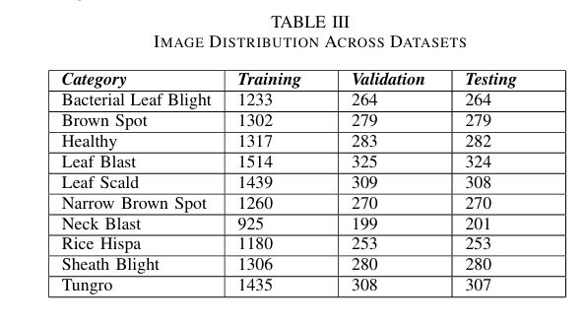
Dataset Split
Training: 70%
Validation: 15%
Testing: 15%
Balanced class distribution

Slide 11
Deep Learning Models Used :
Models Evaluated
Why Vision Transformer(ViT)?
Vision Transformer (ViT)
MobileNetV3
ResNet50
Image divided into small patches
Uses attention mechanism
Learns global image patterns
Pre-trained on ImageNet

Slide 12
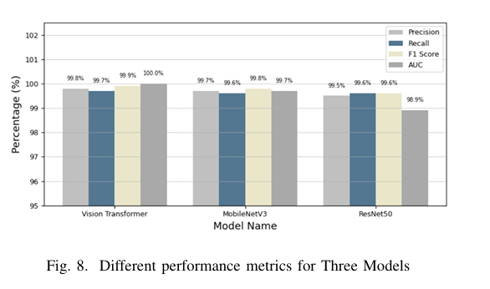
Performance Comparison

Slide 13
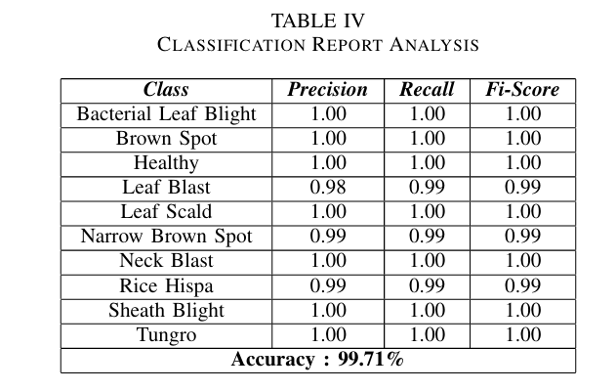
Classification Report

Slide 14
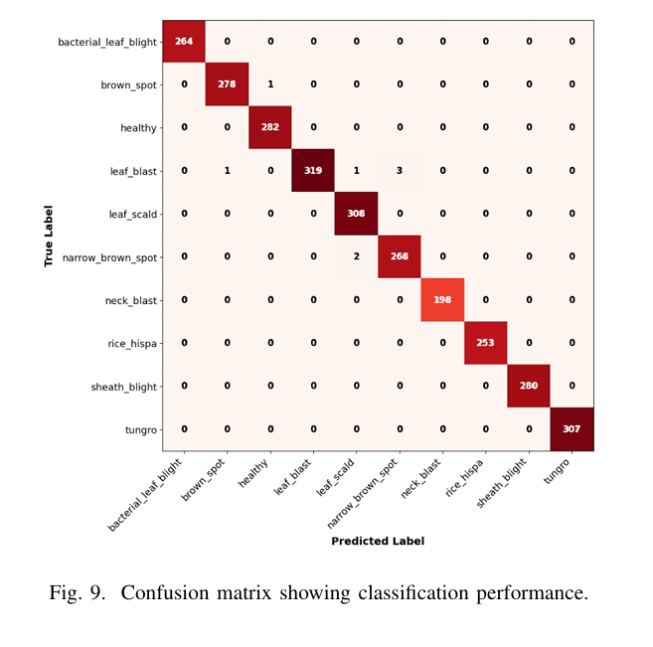
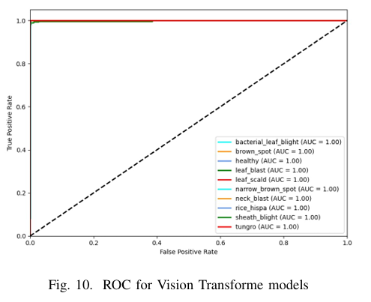
Confusion Matrix Analysis
ROC Analysis
Observations
Key Observation
Most predictions are correct
Very few misclassifications
Strong class separation
ViT shows best AUC score
Very high class separability

Slide 15
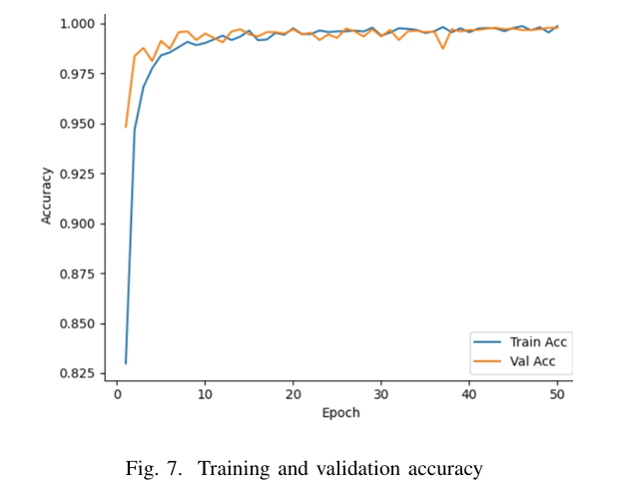
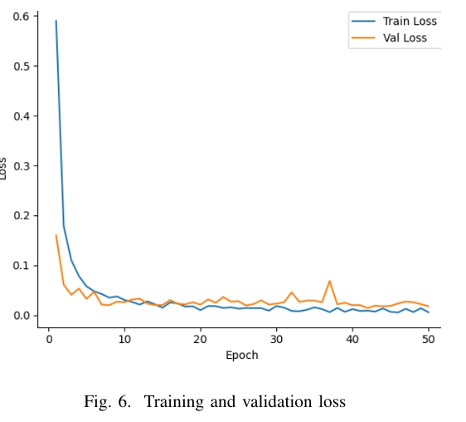
Accuracy & Loss Curves
Accuracy & Loss Curves
High training accuracy
High validation accuracy
Loss decreases quickly
Stable training process
No serious overfitting

Slide 16
Current Limitations
Future Directions
Only RGB images used
Real field testing not done
Hardware delay not tested
Real-time deployment
Use drone and edge devices
Add explainable AI
Test on other crops

Slide 17
REFERENCE
[1] C. K. Jha, ”Rice Plant Diseases Classification using a New Convolutional Neural Network based Approach,” 2024 First International Conference on Electronics, Communication and Signal Processing (ICECSP), New Delhi, India, 2024, pp. 1-4, doi: 10.1109/ICECSP61809.2024.10698072.
[2] Kamilaris, Andreas, and Francesc X. Prenafeta-Bold´u. ”Deep learning in agriculture: A survey.” Computers and electronics in agriculture 147 (2018): 70-90.
[3] Y. Zhou, Z. Qiu, H. Xiang, J. Tao, X. Wang and C. Liang, ”Large-Scale Vision Transformer Model for Image Recognition in Power System,” 2024 20th International Conference on Natural Computation, Fuzzy Systems and Knowledge Discovery (ICNC-FSKD), Guangzhou, China, 2024, pp. 1-5, doi: 10.1109/ICNC-FSKD64080.2024.10702250.
[4] Touvron, H., Cord, M., Douze, M., Massa, F., Sablayrolles, A., J´egou, H. (2021, July). Training data-efficient image transformers distillation through attention. In International conference on machine learning (pp. 10347-10357). PMLR.
[5] Yang, L.; Yu, X.; Zhang, S.; Long, H.; Zhang, H.; Xu, S.; Liao, Y. GoogLeNet based on residual network and attention mechanism identification of rice leaf diseases. Comput. Electron. Agric. 2023, 204, 107543.

Slide 18
Thank You!

